Slide 1
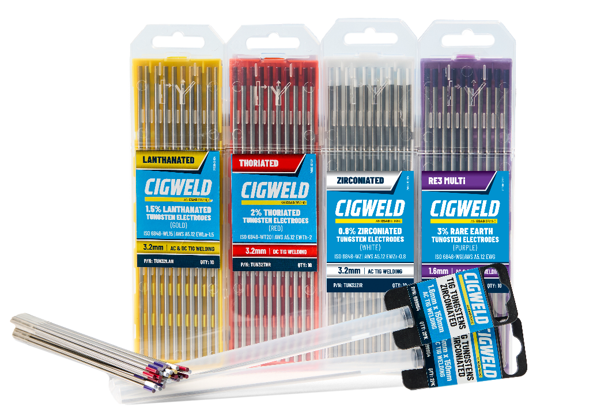
TIG WELDING
TUGSTEN
ELECTRODES
Conform to AWS A5.12 | ISO 6848
TUNGSTENS FOR ANY TIG WELDING APPLICATION !
CIGWELD’s Tungsten Electrodes are essential for TIG welding, offering exceptional durability due to the tungsten’s extremely high melting point of approximately 3400°C. This allows the electrode to sustain a stable electric arc between the workpiece and the electrode without rapid wear. Various types of tungsten electrodes are available, each tailored to specific welding applications. For guidance on selecting the right electrode, refer to the AWS A5.12 and ISO 6848 standards, which provide detailed information on CIGWELD's tungsten electrode offerings.
TUNGSTEN ELECTRODE SELECTION GUIDE
CLASSIFICATION | SIZE | CURRENT SUITABILITY | COMPOSITIONS | WELDABLE MATERIALS
2% THORIATED
WT20 | EWTh-2 Provides excellent arc starting, stability, and current capacity. | 1.6mm X 175mm 2.4mm X 175mm 3.2mm X 175mm | DC | 97.7%~ 98.2% W 1.7%~2.2% ThO₂ ≤ 0.1% Others | Mild & Carbon Steel, Stainless Steel, Nickel, Titanium and Copper Alloys.
1.5% LANTHANATED
WL15 | EWLa-1.5 Provides excellent arc starting and stability, similar to Thoriated electrodes. | 1.6mm X 175mm 2.4mm X 175mm 3.2mm X 175mm | AC/DC | 98.1%~98.5% W 1.3%~1.7% La₂O₃ ≤ 0.2% Others | Aluminum, Copper Alloys, Nickel, Stainless Steel, Mild & Carbon Steel and Titanium
3% RARE EARTH
WG | EWG Excellent arc stability, low wear rate, and superior arc starting, even at lower amperages. | 1.6mm X 175mm/150mm 2.4mm X 175mm/150mm 3.2mm X 175mm | AC/DC | 97.7%~98.1 W 1.8~2.2% La₂O₃+ YO₂+WZrO₂ ≤ 0.1% Others | Aluminum, Copper Alloys, Nickel, Stainless Steel, Mild & Carbon Steel and Titanium
0.8% ZIRCONIATED
(WZ | EWZr-0.8) Excellent arc stability and resistance to contamination. | 1.6mm X 175mm/150mm 2.4mm X 175mm/150mm 3.2mm X 175mm | AC | 98.9%~99.1% W 0.7~0.9% ZrO₂ ≤ 0.2% Others | Aluminium and Magnesium Alloys

Slide 2

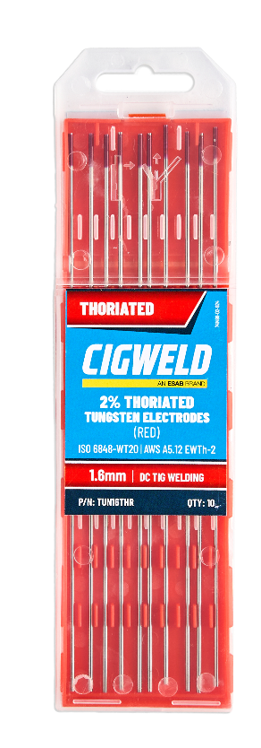
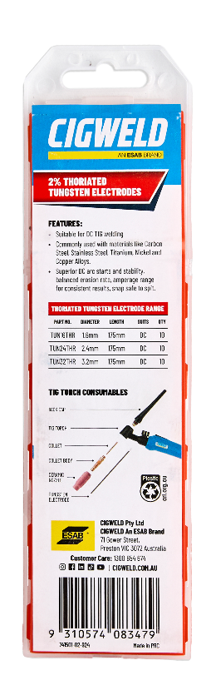


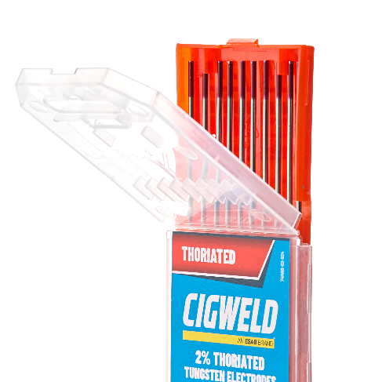

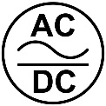
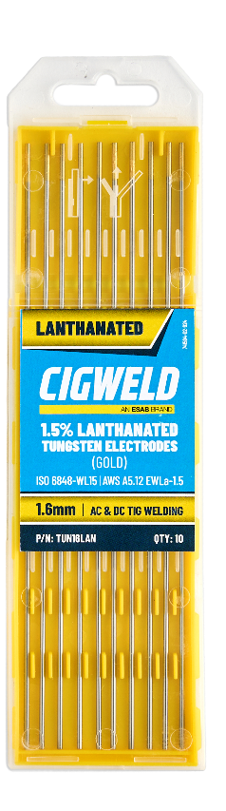
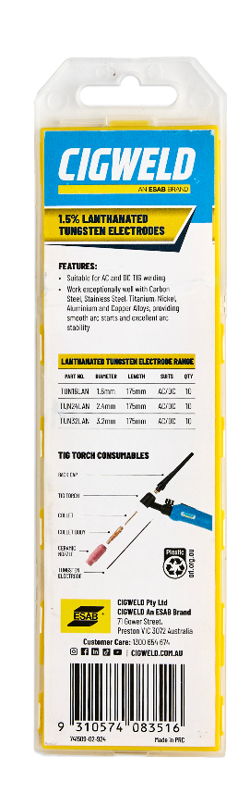


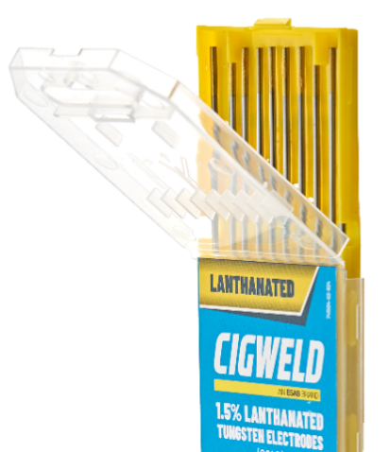

2% THORIATED TUNGSTEN ELECTRODES
FEATURES:
Suitable for DC TIG welding.
Commonly used with materials like Carbon Steel, Stainless Steel, Titanium, Nickel and Copper Alloys.
Superior DC arc starts and stability, balanced erosion rate.
Excellent low amperage stability for care on thin materials.
Clean snap for a safe split.
THORIATED: 10 Pack
1.6mm x 175mm
P/N: TUN16THR
THORIATED: 10 Pack
2.4mm x 175mm P/N: TUN24THR
THORIATED: 10 Pack 3.2mm x175mm P/N: TUN32THR
1.5% LANTHANATED TUNGSTEN ELECTRODES
FEATURES:
Suitable for AC and DC TIG welding.
Work exceptionally well with Carbon Steel, Stainless Steel, Titanium, Nickel, Aluminium and Copper Alloys, providing smooth arc starts and excellent arc stability.
Good ball forming when used for AC-TIG welding on Aluminium and Aluminium Alloys.
LANTHANATED: 10 Pack
1.6mm x 175mm
P/N: TUN16LAN
LANTHANATED: 10 Pack 2.4mm x 175mm P/N: TUN24LAN
LANTHANATED: 10 Pack 3.2mm x 175mm
P/N: TUN32LAN
CIGWELD Data Sheet
TUNGSTEN ELECTRODES PDS V2-2025
CIGWELD Pty Ltd An ESAB Brand.
www.cigweld.com.au
V1-2024

Slide 3

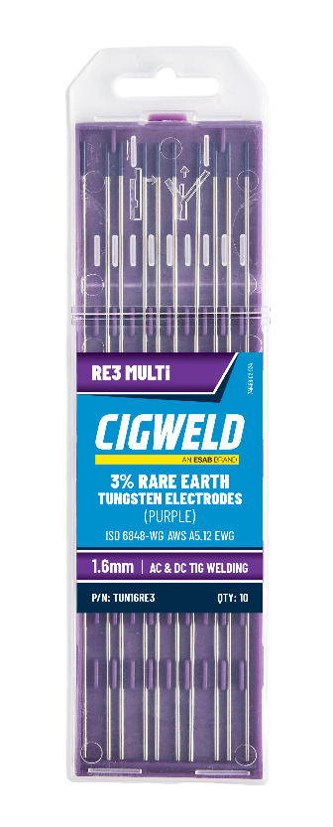
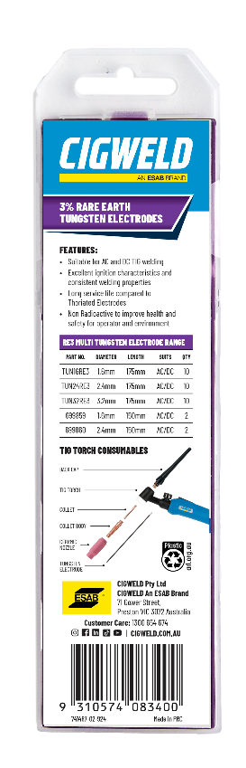



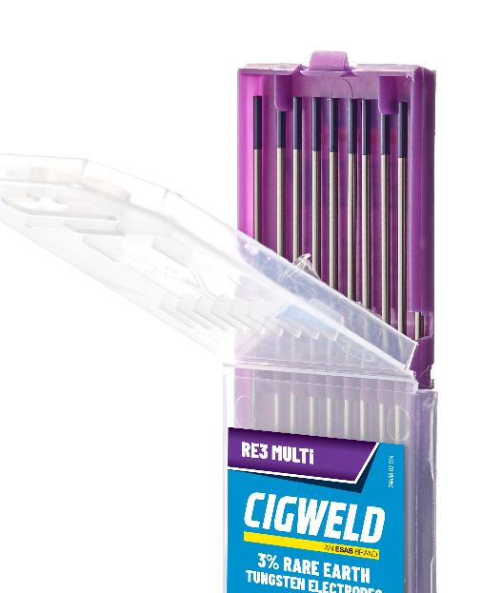
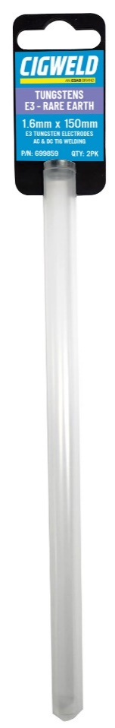
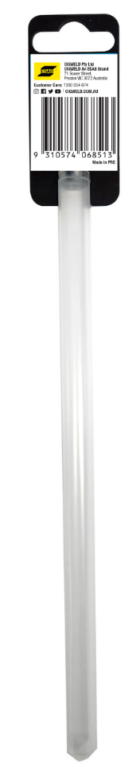



3% RARE EARTH TUNGSTEN ELECTRODES
FEATURES:
Suitable for AC and DC TIG welding.
Excellent ignition characteristics and consistent welding properties.
Holds sharp needle points longer between re-sharpening, compared to Thoriated Tungstens.
Due to their great ignition characteristics and consistent welding properties, they are well suited for Automated welding applications.
Made from Lanthanum, Zirconium and Yttrium in a specific chemical analysis to provide cooler welding temperatures at the tungsten tip.
Non-Radioactive to improve health and safety for operator and environment.
RARE EARTH: 10 Pack 1.6mm x 175mm P/N: TUN16RE3
RARE EARTH: 10 Pack 2.4mm x 175mm P/N: TUN24RE3
RARE EARTH: 10 Pack 3.2mm x 175mm P/N: TUN32RE3
RARE EARTH: 2 Pack
1.6mm x 150mm
P/N: 699859
RARE EARTH 2 Pack
2.4mm x 150mm P/N: 699860
CIGWELD Data Sheet
TUNGSTEN ELECTRODES PDS V2-2025
CIGWELD Pty Ltd An ESAB Brand.
www.cigweld.com.au
V1-2024

Slide 4
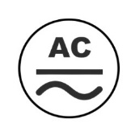
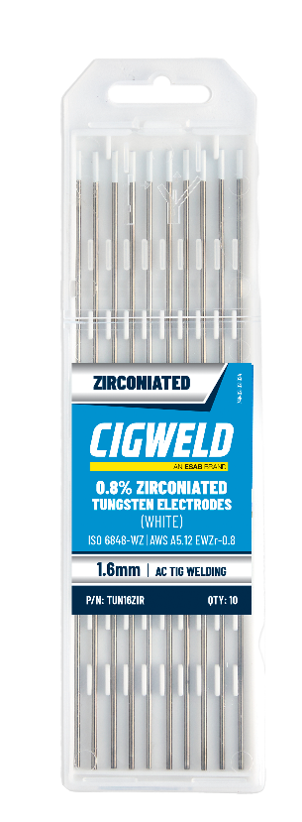
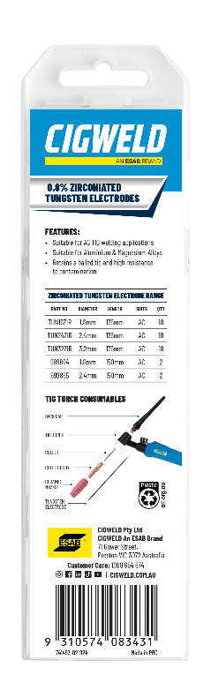



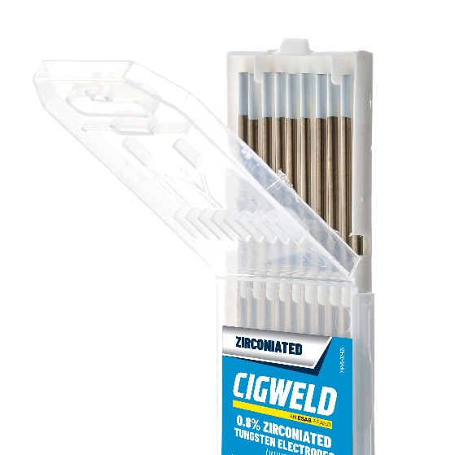
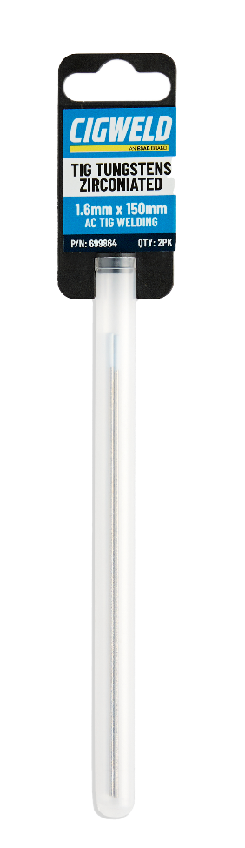
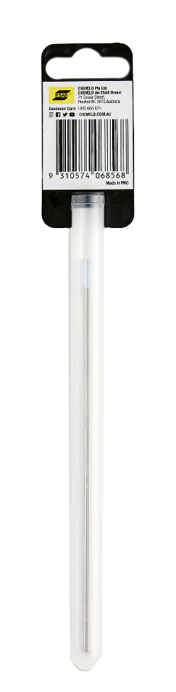


0.8% ZIRCONIATED TUNGSTEN ELECTRODES
FEATURES:
Suitable for AC TIG welding applications.
Suitable for Aluminium and Magnesium Alloys.
Retains a balled tip with high resistance to contamination.
White tipped Zirconiated Tungsten’s have the best ball forming characteristics of all welding tungsten’s, so they’re especially suited to holding a steady arc when welding with AC-Current High Frequency which facilitates the break-up of the Aluminium Oxide layer, which is a critical factor for AC-TIG welding.
NOT FOR USE ON DC CURRENT
ZIRCONIATED: 10 Pack 1.6mm x 175mm
P/N: TUN16ZIR
ZIRCONIATED: 10 Pack 2.4mm x 175mm P/N: TUN24ZIR
ZIRCONIATED: 10 Pack 3.2mm x 175mm P/N: TUN32ZIR
ZIRCONIATED: 2 Pack
1.6mm x 150mm
P/N: 699864
ZIRCONIATED: 2 Pack
2.4mm x 150mm P/N: 699865
CIGWELD Data Sheet
TUNGSTEN ELECTRODES PDS V2-2025
CIGWELD Pty Ltd An ESAB Brand.
www.cigweld.com.au
V1-2024

